Slide 1
Self-Powered Automated Refuse Cart (SPARC)
Group 12
Alexis Drayton Chris Vento
Sean McGarvey Wyatt Schmitz
Sponsored By:

Slide 2
Project Motivation
Automation of simple domestic tasks
Accessibility for those who cannot physically move trash
Quality of life improvement for people with abnormal working schedules

Slide 3
Goals and Objectives
Autonomously carry a Garbage Bin down a driveway to a curb, and return back to a charging station, based on a schedule.
Detects and Avoid obstacles.
Schedule setting, Manual control available through a mobile application
Autonomously connects to recharging station

Slide 4
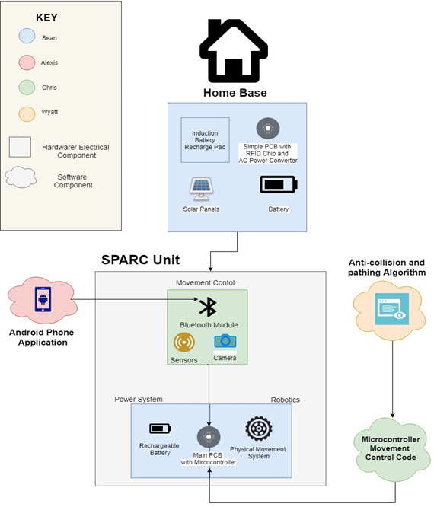
Notes:
Alexis: High Level Concept Block Diagram

Slide 5
Specifications and Requirements
Capable of carrying up to 50lbs.
User Interface with a Mobile Application
Battery capacity of 20Ah
User manual control
1 camera for destination recognition
Collision avoidance capabilities up to 2 meters
Chassis no smaller than Trash can (2 ft x 2ft)
Notes:
Important Events: Device out of Range, Moving back and forth from the curb

Slide 6
Operating Procedure
User Sets the schedule on the application and calibrates a base path from curbside to the home base.
GPS location is saved at both points.
Once the path is set, SPARC remains in standby until schedule is triggered.
Wake up on schedule interrupt.
Follow the reverse path checking for destination location as it goes.
Drives to Pixy Cam tag until it can’t see it.
Standby for a wait period for trash collection.
Once wait period ends, return to home base and remains in standby until next schedule interrupt.

Slide 7
Hardware Overview

Slide 8
Charging Platform (Home Base)
Plugs into standard 120V AC Wall outlet.
AC/DC Laptop Charger with Barrel Jack
18V, 3A Output
Three 2A 16V Regulators for output to Main Unit
One 2A 3.3V Regulator to power RF Receivers.
Two RF Receivers (315MHz and 433MHz), into SR NOR Latch to enable or disable output from 16V Regulators

Slide 9
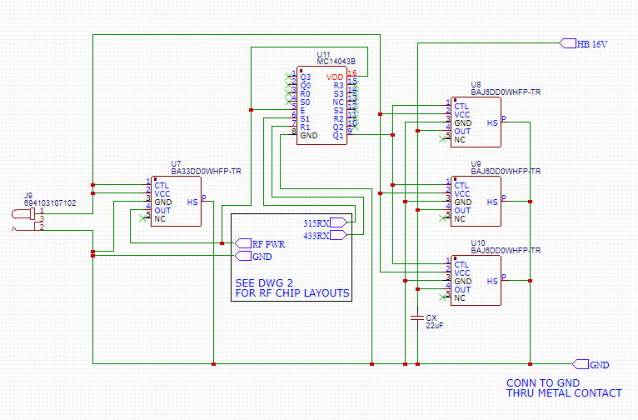

Slide 10
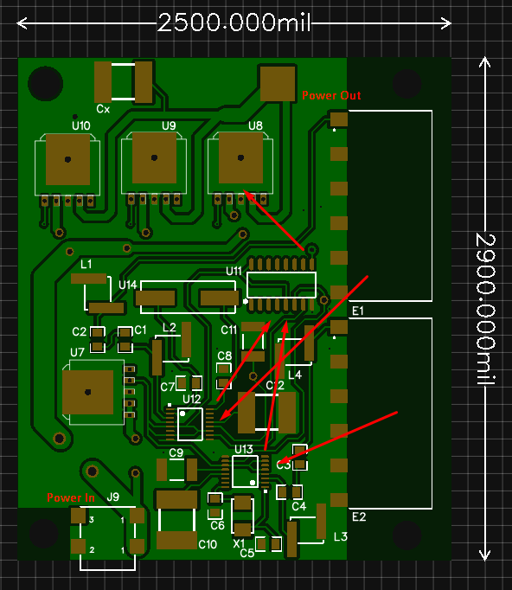

Slide 11
Internal Power
14.8V Battery Bank
Thirty-Two 18650 Batteries, 4-series, 8 parallel, 20,000mAh
8 Overcharge Protection chips, 2 per series cell
Eleven 2A 12V Regulators for Motors
One 2A 5V Regulator for USB/PixyCam and IR Sensor
One 2A 3.3V Regulator for MCU, GPS, Bluetooth, and RF Transmitters.
Each Regulator protected by an ICL.

Slide 12
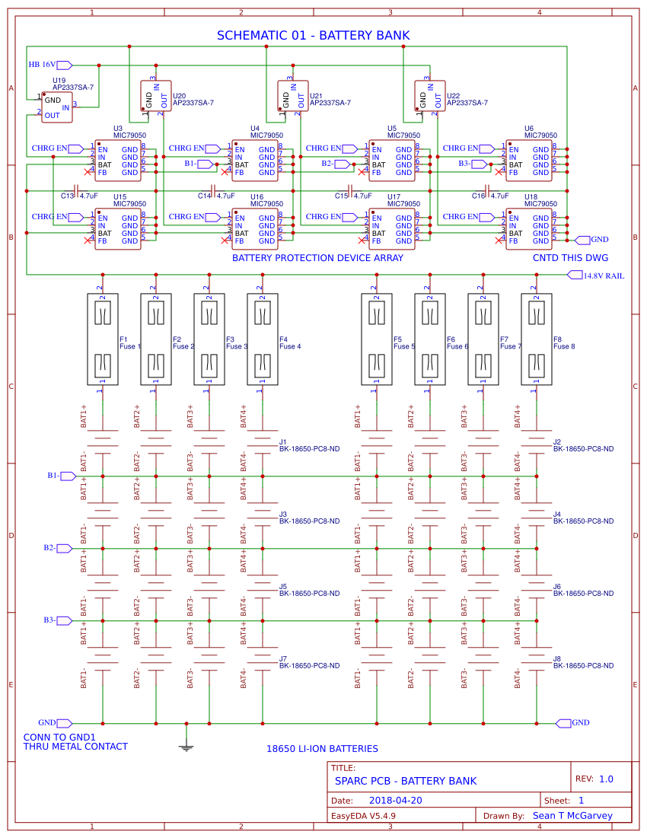
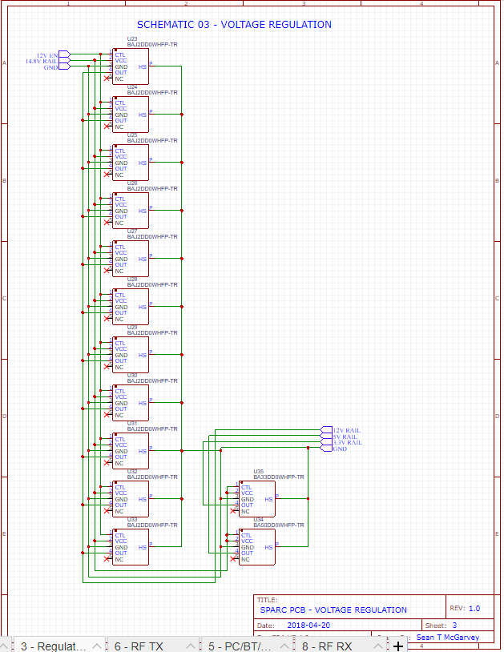

Slide 13
Motors
2 DC Motors,12V, 17200RPM, 4.47oz-in rated torque
6A draw at rated torque
Through 81:1 Gearbox
362.07 oz-in torque + 212 RPM after gearbox conversion.
Circuit designed to carry Max of 10A per motor
At 10A, 600 oz-in torque.
Should be able to pull 1200 oz. without damage to circuit.
50 Pounds of trash (estimated capacity of trash can) = 800 oz
Motors controlled by H-Bridge, controlled by MCU

Slide 14
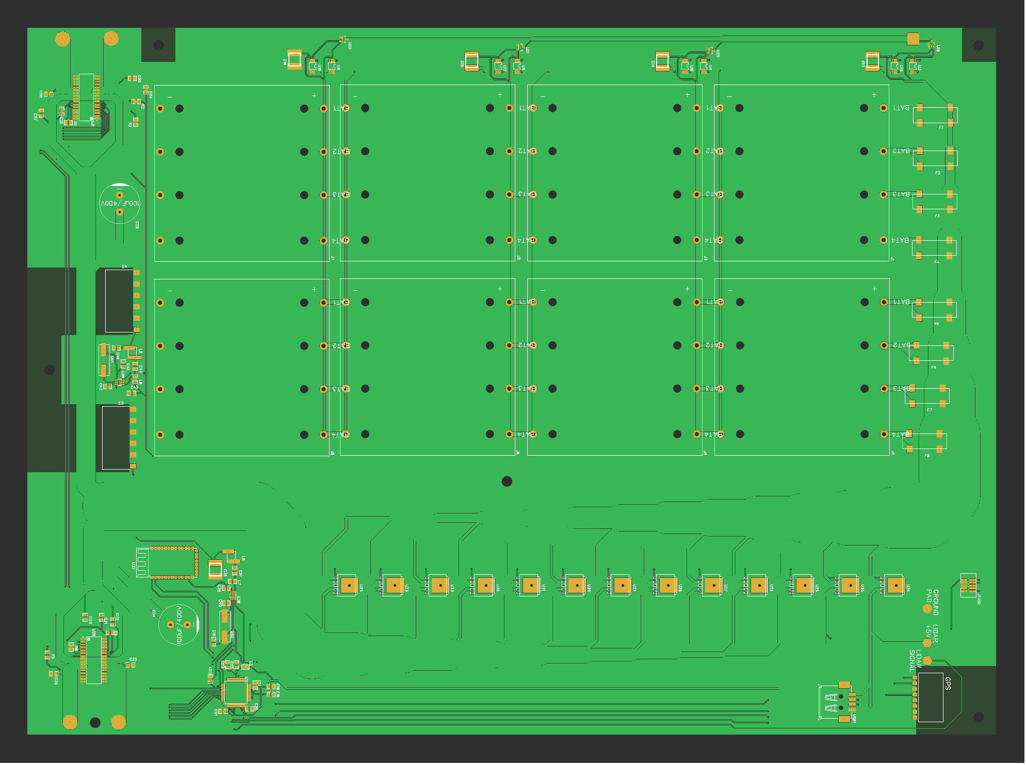
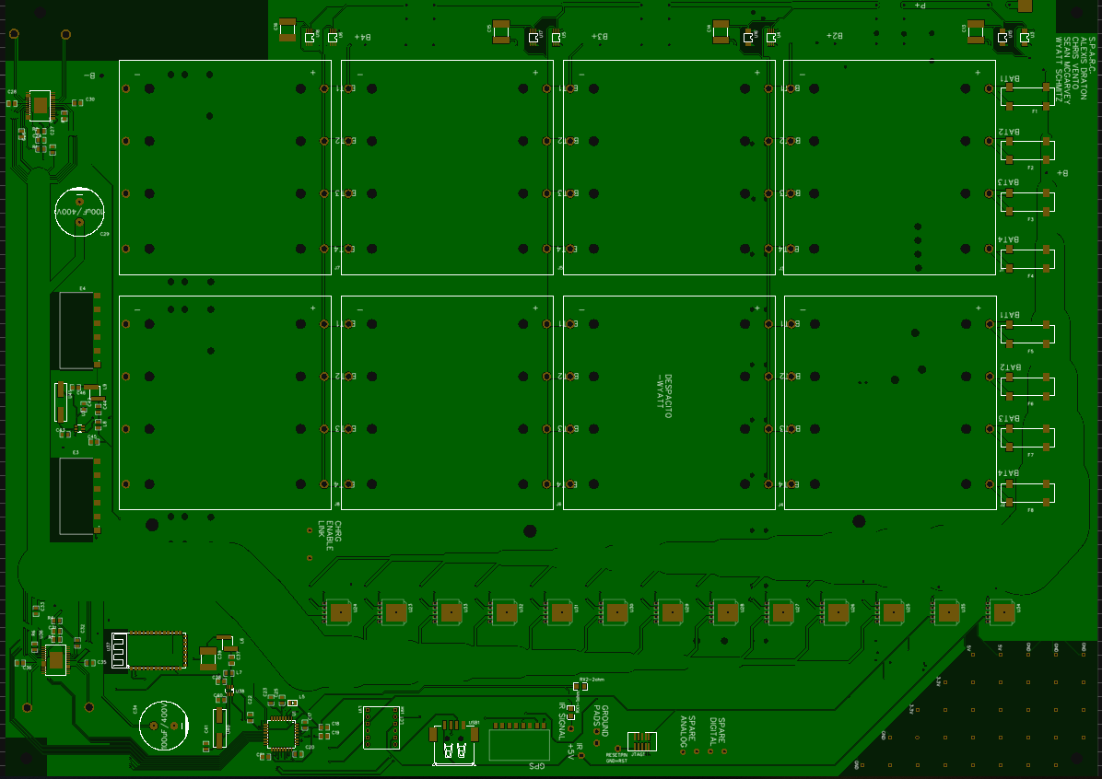

Slide 15
Chassis
Built from Aluminum, edges sealed to prevent rain damage.
4 wheels, 2 front wheels powered, 2 back caster wheels to allow easy turning.
Has a location to attach the trash can via straps.

Slide 16
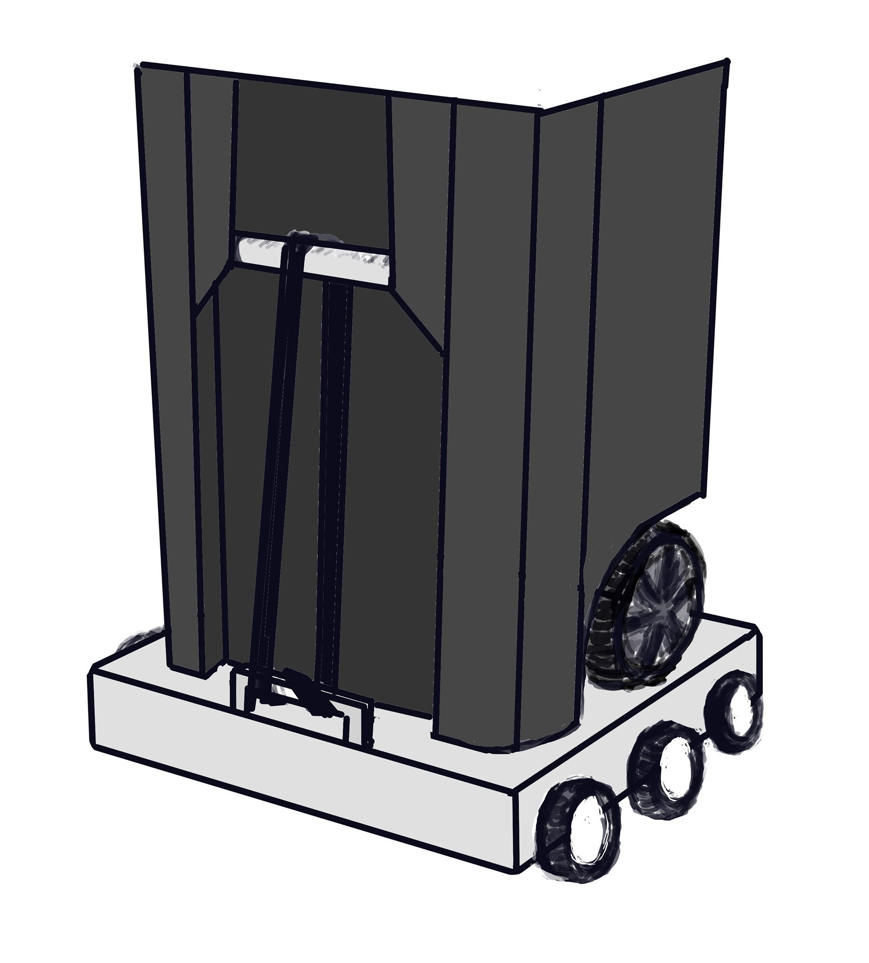
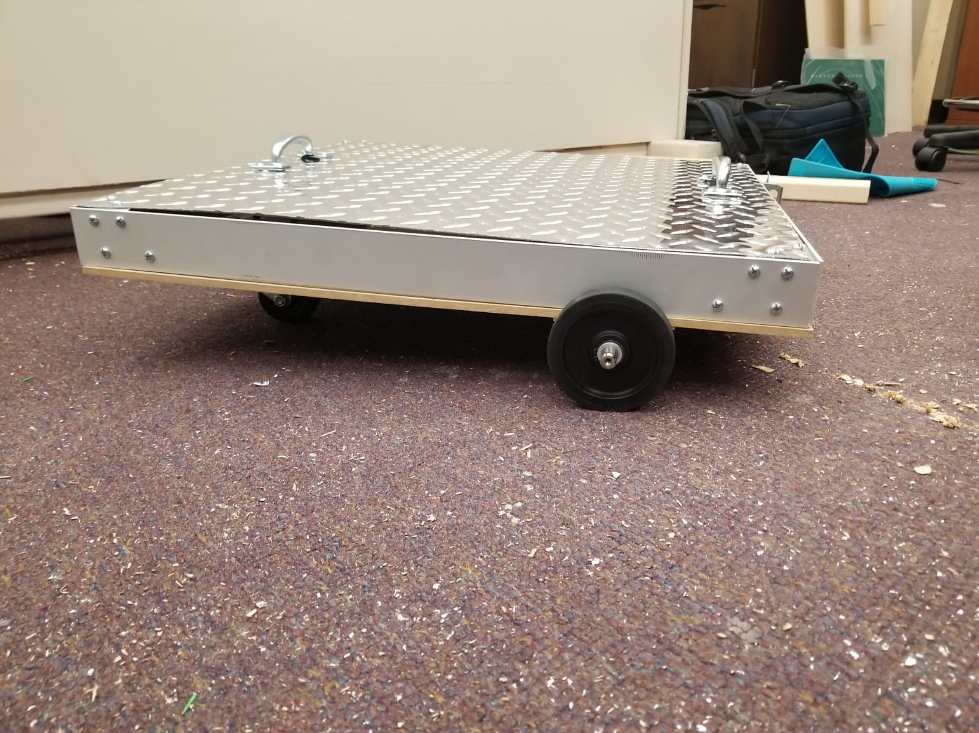
Chassis Design

Slide 17
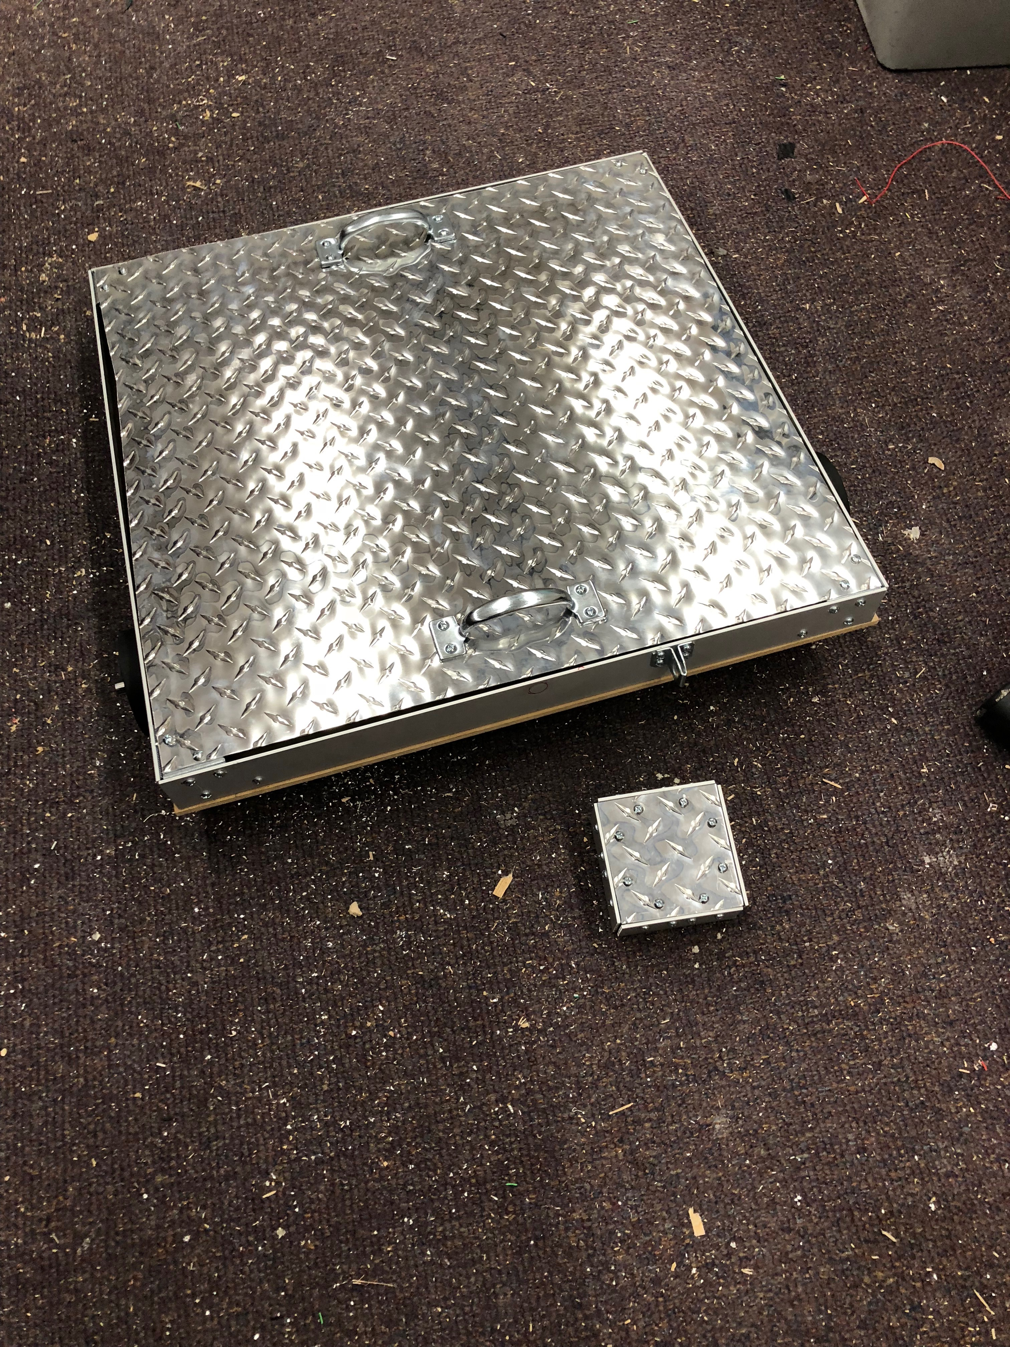
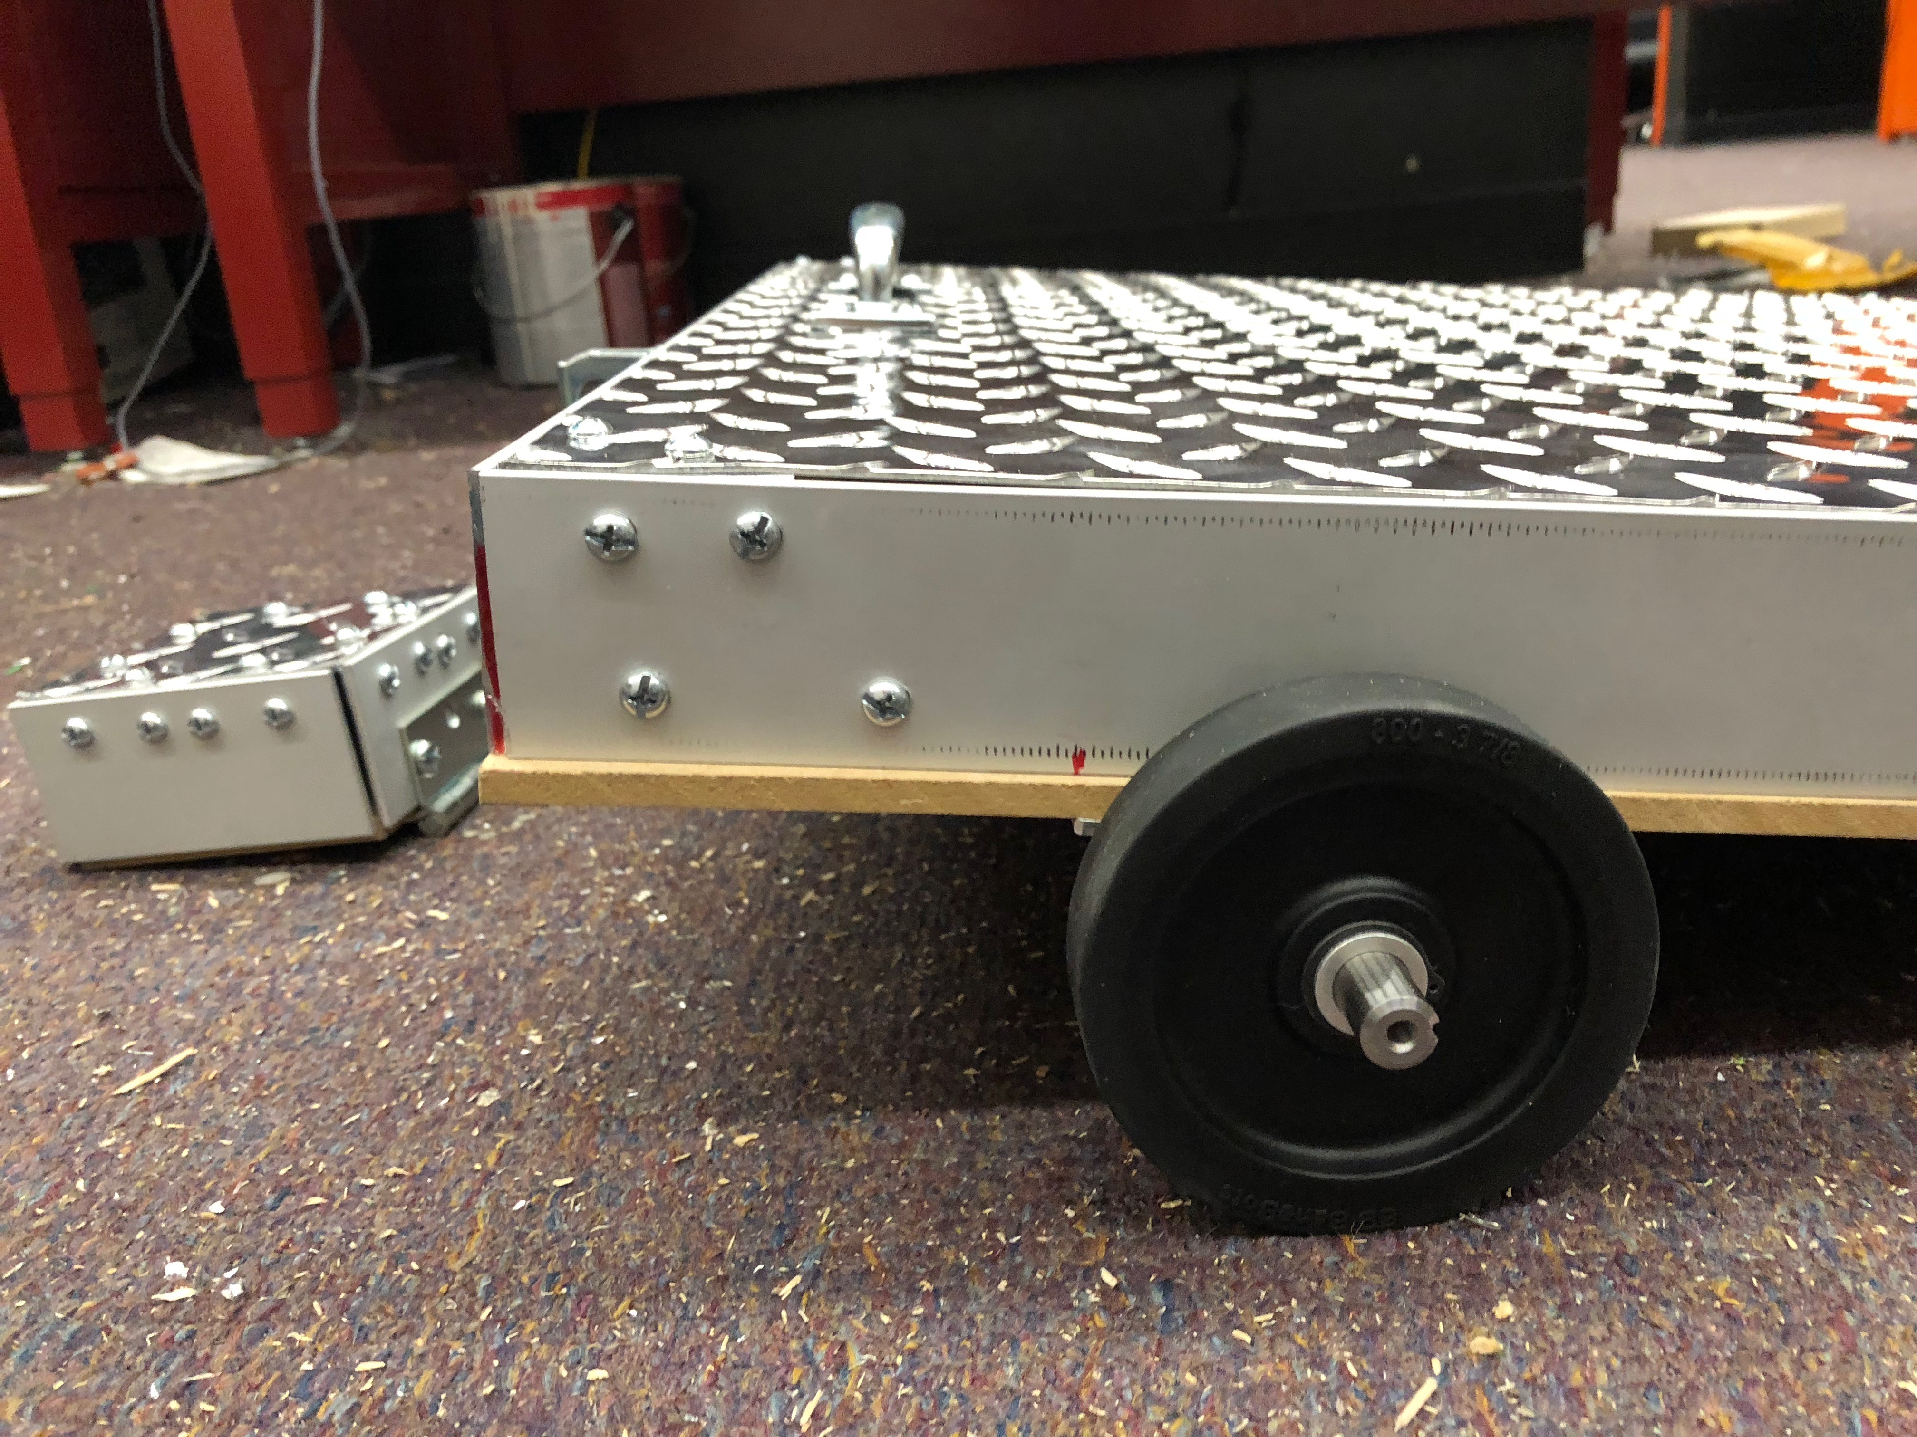

Slide 18
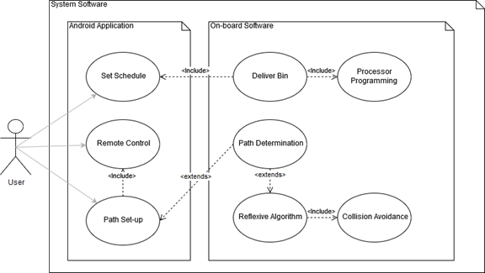
Software Development
Three Parts:
Pathing & Collision Avoidance
Firmware
Mobile Application

Slide 19
Pathfinding

Slide 20
SLAM - Challenges for SPARC Design
Price point must be competitive; Taking out the trash is not likely to be worth several hundreds of dollars to the average user.
Fully mapping the operation area is not possible; unknown property boundaries must be respected
Artificial Landmarking has a very high utility cost in accessibility, which conflicted with our design goals of designing a device that has a high accessibility factor.
Notes:
Particular Challenges that are posed by the SPARC’s design problem. Needs to be inexpensive! No LIDAR, IR over Sonar/microwave Many other robot vision SD projects researched for the SPARC had a full mapping of the operational area before standard functionality begins; not possible for the SPARC as the operation space is not defined and bound legally. Adding markers for signaling makes the SPARC ever more difficult for users that have accessability challenges, which runs against our core design inspirations so use of this design solution must be minimal

Slide 21
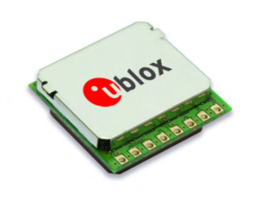
GPS Module
The Pam 7Q was selected for its relatively low cost and high accuracy.
The SPARC’s slow movement makes its slow baud rate a negligible drawback.
Part Name | Manufacturer | Price | Baud Rate | Accuracy
Pam-7Q | U-Blox America Inc. | $41 | 9600 bps | > 2.0 m
LS20031 | LOCOSYSA Technology Inc. | $60 | 57600 bps | ~ 2.5 m
Venus638FLPx-L | SkyTraq Technology Inc. | $50 | 115200 bps | ~ 2.5 m

Slide 22
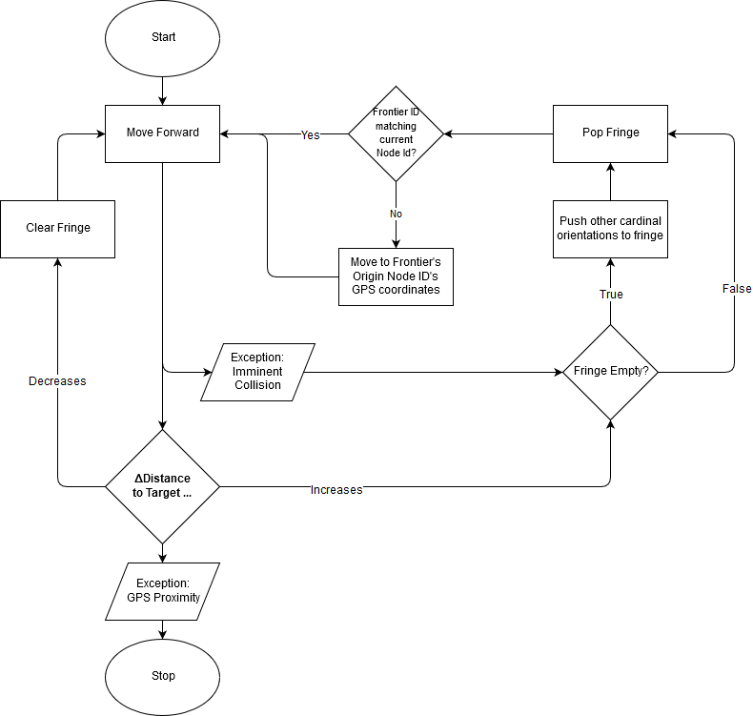
Algorithm Flowchart
Diagram

Slide 23
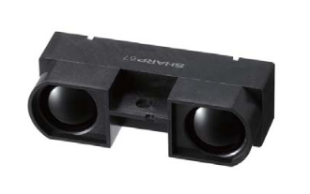
Rangefinding
Opted for Infrared over Ultrasonic; noise damping of shrubberies was of concern.
LiDAR too far out of price target
Part Name | Manufacturer | Price | Range | Type
GP2Y0A710K0F | SHARP | $16 | 100-550cm | Infrared
DE LiDar TF02 | Benewake | $99 | 0.4-22m | LIDAR
SEN136B5B | Seeed Studio | $15 | 3-400cm | Ultrasonic
Notes:
We opted

Slide 24
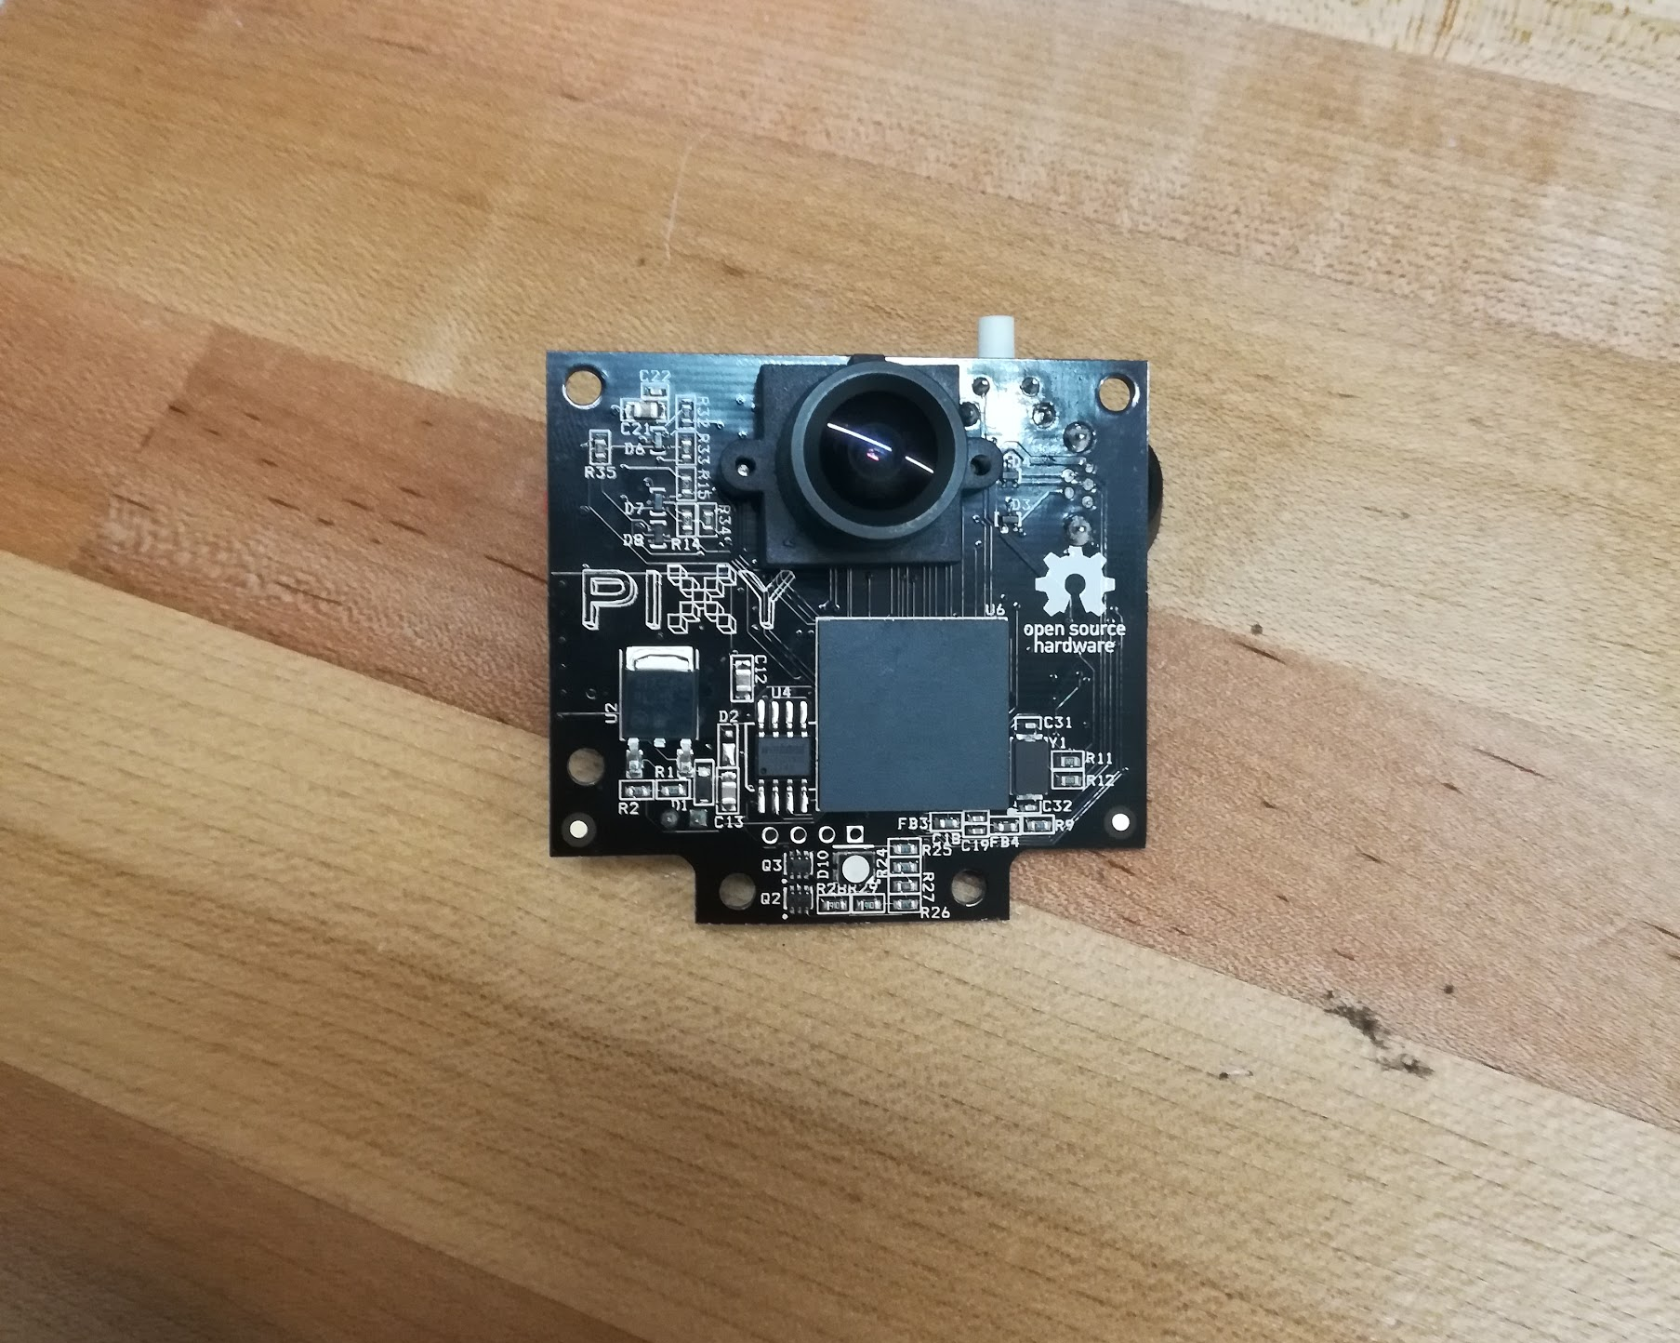
PixyCam
Integrated Computer Vision device we use to identify the start and endpoints.
Uses color filtering to identify pre-programmed objects.
Colored markers are applied on charge station and on single stake driven at the endpoint for high precision detection.

Slide 25
Firmware

Slide 26
Microcontroller Comparison
A microcontroller needed to be chosen to run the code and interface with the modules
Microcontroller | Manufacturer | Total # of Pins | FLASH(KB) | SRAM (KB) | Cost
ATSAMD21J18A-AUT | Atmel | 64 | 256 | 32 | $3.39
MSP432P401RIRGC | Texas Instruments | 48 | 256 | 64 | $6.86
Decided on the ATSAMD21J18A-AUT for its large number of pins, low cost, and compatibility with other components like the PixyCam
Notes:
Arduino easy

Slide 27
Firmware
Interfacing with the Bluetooth module and app
Pulling inputs from camera and other sensors
Sending output to motor control units (MCU)
Initiating standby modes and handling user-scheduled activation

Slide 28
Mobile Application

Slide 29
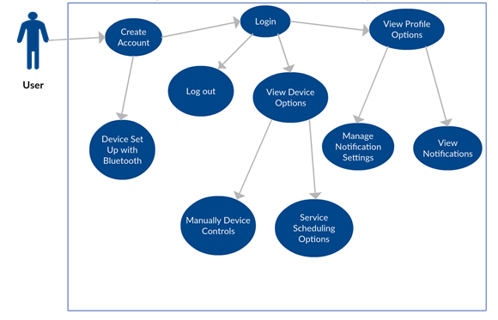
Mobile Application
The main connection between the user and the SPARC
Android Application
Bluetooth Connection
Service Scheduling and Monitoring
Manual Movement Control
Notes:
The User experience for the SPARC will be defined by the Mobile Application. It will be the main connection between the user and the device.

Slide 30
Bluetooth v Wifi
A wireless connection technology needed to be chosen to connect the application to the SPARC
Bluetooth chosen for this application that values low power consumption, price and ease of implementation
Protocol | Speed | Range | Power Consumption | Stability | Cost
Bluetooth | 25Mbps | 100m | Low | Only 2.4GHz bands | HC06: $$4.02
Wifi | 250Mbps | 200m to 400m | High | Both 2.4GHz and 5Hz bands | ESP8266:$6.95
Notes:
WiFi works on 2 bands (2.4GHz and 5Hz), if the device supports it can be switched between those bands and can select lesser noicy one. Bluetooth works with 2.4GHz.

Slide 31
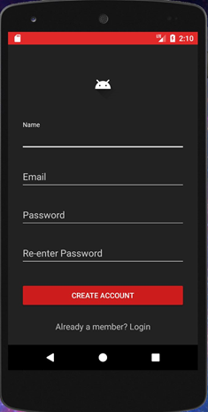
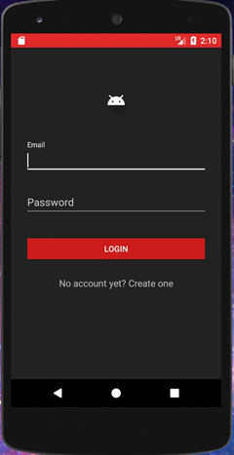
User Interface Design
Sign Up Screen
New user sign up
Login Screen
User sign in

Slide 32
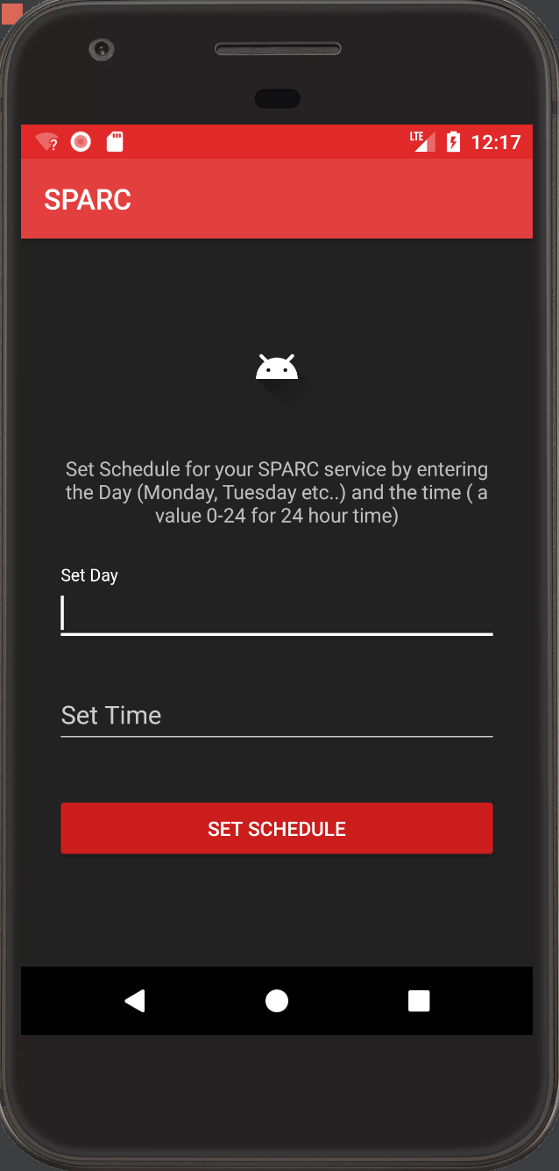
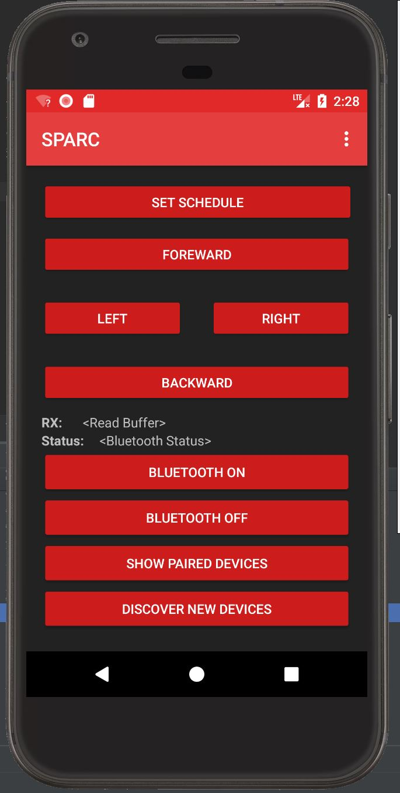
User Interface Design
Set Schedule Screen
User inputs day (Monday, Tuesday, etc.)
User input time in 24 hour time on the hour.
Main Control Screen
SPARC movement controls
Sending the set schedule
Bluetooth functionality
User Settings

Slide 33
Mobile Application Process

Slide 34
Administrative Content

Slide 35
Budget
Main Components | Estimated Budget
Chassis and Trash Can containment parts | ~$200.00
Wheels and other Mechanics | ~$100.00
Printed Circuit Boards | ~$150.00
External Hardware Modules | ~$70.00
Miscellaneous Hardware parts | ~$100.0
Camera | ~$70.00
Power Supply Components | ~$200.00
Microcontroller and other electronics | ~$100.00
Estimated Total: | ~$1000

Slide 36
Work Distribution
 | Hardware | Mobile Application | Firmware | Pathing
Alexis Drayton |  | P | S
Sean McGarvey | P |  | S
Wyatt Schmitz |  |  |  | P
Chris Vento | S |  | P
P: Primary
s: Secondary
Notes:
Big X for main component
Little x for secondary component

Slide 37
Future Improvements
Detailed notifications to the mobile application.
Improve on current flow to motors to handle more weight.
The use of LIDAR instead of GPS.
Weather proofing and robustness for trash collection.

Slide 38
Questions?

